Slide 1

Basic Discrete Structure : Set
Lecture 4
1

Slide 2
Basic Discrete Structure
Discrete math =
Many discrete structures are built using sets – Sets = collection of objects
Examples of discrete structures built with the help of sets:
• Combinations
• Relations
• Graphs
– study of the discrete structures used to represent discrete objects
2

Slide 3
Set
Definition:
A set is a (unordered) collection of objects.
These objects are sometimes called elements or members of the set.
• Examples:
– Vowels in the English alphabet
– First seven prime numbers.
V = { a, e, i, o, u }
X = { 2, 3, 5, 7, 11, 13, 17 }
3

Slide 4
Representing Set
Representing a set by:
Example:
1) Listing (enumerating) the members of the set.
2) Definition by property, using the set builder notation {x| x has property P}.
• Even integers between 50 and 63.
1) E = {50, 52, 54, 56, 58, 60, 62}
2) E = {x| 50 <= x < 63, x is an even integer}
If enumeration of the members is hard we often use ellipses. Example: a set of integers between 1 and 100
• A= {1,2,3 …, 100}
4

Slide 5
Important set in discrete math
• Natural numbers:
– N = {0,1,2,3, …}
• Integers
– Z = {…, -2,-1,0,1,2, …}
• Positive integers
– Z+ = {1,2, 3.…}
• Real numbers
– R
5

Slide 6
Equality of Set
Definition: Two sets are equal if and only if they have the same elements.
Example:
Note: Duplicates don't contribute anything new to a set, so remove them. The order of the elements in a set doesn't contribute anything new.
Example: Are {1,2,3,4} and {1,2,2,4} equal? No!
• {1,2,3} = {3,1,2} = {1,2,1,3,2}
6

Slide 7
Universal set
Special sets:
– The universal set is denoted by U: the set of all objects under the consideration.
– The empty set is denoted as Ø or { }.
7

Slide 8
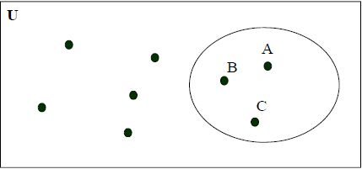
Venn Diagram
A set can be visualized using Venn Diagrams:
– V={ A, B, C }
8

Slide 9

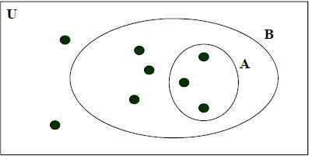

A subset
Definition: A set A is said to be a subset of B if and only if every element of A is also an element of B. We use to indicate A is a subset of B.
Alternate way to define A is a subset of B:
9

Slide 10




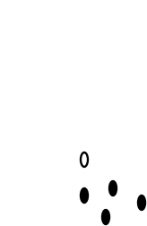
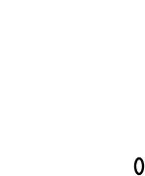


Venn diagram of Empty set
Theorem :
• Empty set is a subset of any set.
U
A
Ø
11

Slide 11



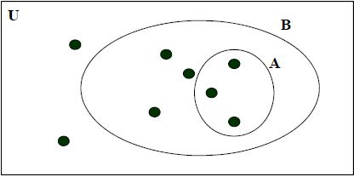
A proper Subset
Definition:
A set A is said to be a proper subset of B if and only if and . We denote that A is a proper
subset of Bwith the notation .
Example: A={1,2,3} B ={1,2,3,4,5} Is: ?
13

Slide 12
A proper Subset
Definition:
A set A is said to be a proper subset of B if and only if and . We denote that A is a proper
subset of Bwith the notation .
Example: A={1,2,3} B ={1,2,3,4,5}
Is: ?Yes.
14

Slide 13
Cardinality
Definition: Let S be a set. If there are exactly n distinct elements in S, where n is a nonnegative integer, we say S is a finite set and that n is the cardinality of S. The cardinality of S is denoted by | S |.
• A={1,2,3,4, …, 20} |A| =20
• | Ø | = 0
15
Examples: • V={1 2 3 4 5}
| V | = 5

Slide 14
Infinite set
Definition: A set is infinite if it is not finite.
Examples:
• The set of natural numbers is an infinite set.
• N = {1, 2, 3, ... }
• The set of real numbers is an infinite set.
16

Slide 15
Power set
Definition: Given a set S, the power set of S is the set of all subsets of S. The power set is denoted by P(S).
Example
• What is the power set of Ø ? P(Ø ) = {Ø}
• What is the cardinality of P(Ø) ? | P(Ø) | = 1.
If S is a set with |S| = n then | P(S) | = ? 2^n
Assume {1,2,3} • P({1,2,3}) = {Ø, {1}, {2}, {3}, {1,2}, {1,3}, {2,3}, {1,2,3} } • |P({1,2,3} | = 8
17

Slide 16
Cartesian Product
Definition: Let S and T be sets. The Cartesian product of S and T, denoted by S x T, is the set of all ordered pairs (s,t), where s ϵ S and t ϵ T. Hence,
• S x T = { (s,t) | s ϵ S ˄ t ϵ T}.
Examples:
19
• S = {1,2} and T = {a,b,c}
• S x T = { (1,a), (1,b), (1,c), (2,a), (2,b), (2,c) }
• T x S = { (a,1), (a, 2), (b,1), (b,2), (c,1), (c,2) }
• Note: S x T ≠ T x S !!!!

Slide 17
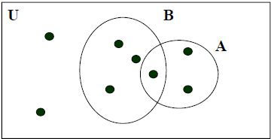
Set Operation
Definition: Let A and B be sets. The union of A and B, denoted by A U B, is the set that contains those elements that are in both A andB.
• Alternate: A U B = { x | x ϵ A V x ϵ B }.
Example:
• A = {1,2,3,6} and B = { 2,4,6,9}
• A U B = { 1,2,3,4,6,9 }
21

Slide 18
Set Operation
Definition: Let A and B be sets. The intersection of A and B, denoted by A ∩ B, is the set that contains those elements that are in both A andB.
• Alternate: A ∩ B = { x | x ϵ A ˄ x ϵ B }.
Example:
• A = {1,2,3} and B = { 2,4,6,9}
• A ∩ B = { 2 }
22

Slide 19
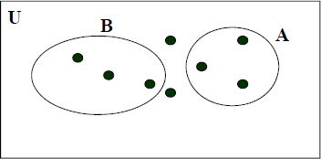
Disjoin Set
Definition: Two sets are called disjoint if their intersection is empty.
• Alternate: A and B are disjoint if and only if A ∩ B = Ø.
Example:
• A={1,2,3,6} B={4,7,8} Are these disjoint?
• Yes.
• A ∩ B = Ø
23

Slide 20

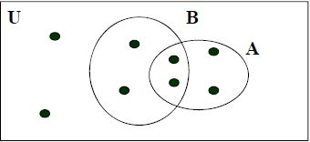
Set Difference
Definition: Let A and B be sets. The difference of A and B, denoted by A - B, is the set containing those elements that are in but not in B. The difference of A and B is also called the complement of B with respect to A.
• Alternate:
Example: A= {1,2,3,5,7} B = {1,5,6,8} • A - B ={2,3,7}
25

Slide 21

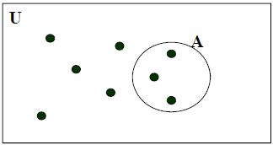
Complement of a Set
Definition: Let U be the universal set: the set of all objects under the consideration.
Definition: The complement of the set A, denoted by Ã, is the complement of A with respect to U. • Alternate: Alternate:
Example: U={1,2,3,4,5,6,7,8} A ={1,3,5} • Ã={2,4,6,7,8}
26

Slide 22
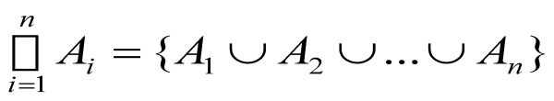


Generalized union
Definition: The union of a collection of sets is the set that contains those elements that are members of at least one set in the collection.
Example:
A₁= {1} A₂= {1,2} A₃= {1,2,3} ………….. …………..
• Let A_{i}= {1,2,...,i} i =1,2,...,n
A_{n}{1,2,3,4,...,n}
27

Slide 23
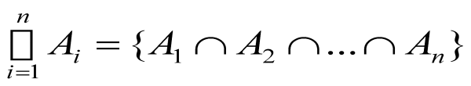

Generalized intersection
Definition: The intersection of a collection of sets is the set that contains those elements that are members of all sets in the collection.
Example:
• Let A_{i}= {1,2,...,i} i =1,2,...,n
A₁= {1} A₂= {1,2} A₃= {1,2,3} ………….. …………..
A_{n}{1,2,3,4,...,n}
28

Slide 24
Computer representation of set
How to represent sets in the computer?
• One solution: Data structures like a list
• A better solution: Assign a bit in a bit string to each element in the universal set and set the bit to 1 if the element is present otherwise use 0
Example:
All possible elements: U={1 2 3 4 5}
• Assume A={2,5}
– Computer representation: A = 01001
• Assume B={1,5}
– Computer representation: B = 10001
29

Slide 25
Computer representation of set
Example:
• A = 01001
• B = 10001
• The union is modeled with a bitwise or
• A U B = 11001
• The intersection is modeled with a bitwise and
• A ∩ B = 00001
• The complement is modeled with a bitwise negation
• Ã =10110
30

Slide 26
Basic Discrete Structure :
Set and Function
31

Slide 27
Quiz Problem 1
1.
Suppose the following two statements are true. I love Dad or I love Mom
If I love Dad then I love Mom
love Mom? Use propositional logic to answer the questions.
Does it necessarily follow that I love Dad? Does it necessarily follow that I
P (I love dad) | Q (I love mom) | P˅Q | P→Q
F | F | F | T
F | T | T | T
T | F | T | F
T | T | T | T
32

Slide 28
Quiz Problem 1
1.
Suppose the following two statements are true. I love Dad or I love Mum
If I love Dad then I love Mum
love Mum? Use propositional logic to answer the questions.
Does it necessarily follow that I love Dad? Does it necessarily follow that I
P (I love dad) | Q (I love mum) | P˅Q | P→Q
F | F | F | T
F | T | T | T
T | F | T | F
T | T | T | T
33

Slide 29
Quiz Problem 2
2.
Consider the following specification with two predicate symbols p₁≡(<), p₂≡(=) two function symbols f₁≡(+), f₂≡(×) two constant symbols c ≡(0), c ≡(1)
1 2
Let domain of discourse be <Z₊ ∪ {0}> where Z₊={1,2,….} What are the truth values of the following statements?
i.∀x p₁(c₁,x)
ii.∀x∀y∃z (p₁(x,z) ∧ p₁(z,y))
iii.∀x∀y p₂ (f₁(x,c₂),y), f₁ (x,y),y))
i. | False | 0<x
34

Slide 30
Quiz Problem 2
2.
Consider the following specification with two predicate symbols p₁≡(<), p₂≡(=) two function symbols f₁≡(+), f₂≡(×) two constant symbols c ≡(0), c ≡(1)
1 2
Let domain of discourse be <Z₊ ∪ {0}> where Z₊={1,2,….} What are the truth values of the following statements?
i.∀x p₁(c₁,x)
ii.∀x∀y∃z (p₁(x,z) ∧ p₁(z,y))
iii.∀x∀y p₂ (f₁(x,c₂),y), f₁ (x,y),y))
i. | False | 0<x
ii. | False | x< z ∧ z<y
35

Slide 31
Quiz Problem 2
2.
Consider the following specification with two predicate symbols p₁≡(<), p₂≡(=) two function symbols f₁≡(+), f₂≡(×) two constant symbols c1 ≡(0), c 2≡(1)
Let domain of discourse be <Z₊ ∪ {0}> where Z₊={1,2,….} What are the truth values of the following statements?
i.∀x p₁(c₁,x)
(X+1)y
xy+y
ii.∀x∀y∃z (p₁(x,z) ∧ p₁(z,y))
iii.∀x∀y p₂ (f₁(x,c₂),y), f₁ (x,y),y))
i. | False | 0<x
ii. | False | x< z ∧ z<y
iii | True | xy +y = xy+y
37

Slide 32
Quiz Problem 3
3.
Let A be the set of English words that contains x, and B be the set of English words that contain the letter q. Express each of these sets as a combination of A and B.
i. The set of English words that do not contain the letter x.
ii. The set of English words that contain an x but not a q.
iii. The set of English words that do not contain either an x or a q.
i. | U – A
38

Slide 33
Quiz Problem 3
3.
Let A be the set of English words that contains x, and B be the set of English words that contain the letter q. Express each of these sets as a combination of A and B.
i. The set of English words that do not contain the letter x.
ii. The set of English words that contain an x but not a q.
iii. The set of English words that do not contain either an x or a q.
i. | U – A
ii. | A –B
39

Slide 34
Quiz Problem 3
3.
Let A be the set of English words that contains x, and B be the set of English words that contain the letter q. Express each of these sets as a combination of A and B.
i. The set of English words that do not contain the letter x.
ii. The set of English words that contain an x but not a q.
iii. The set of English words that do not contain either an x or a q.
i. | U – A
ii. | A –B
iii. | U – (A ∩ B)
40

Slide 35
Quiz Problem 4
4.
Let A = {a, b, c}, B = {x, y} and C= {0, 1}. Find C × B × A.
C×B | {{0,x}{0,y},{1,x}{1,y}}
41

Slide 36



Quiz Problem 4
4.
Let A = {a, b, c}, B = {x, y} and C= {0, 1}. Find C × B × A.
C×B {{0,x}{0,y},{1,x}{1,y}}
C × B × A
{{0,x,a}, {0,x,b}, {0,x,c},{0,y,a}, {0,y,b}, {0,y,c},{1,x,a}, {1,x,b}, {1,x,c},{1,y,a}, {1,y,b}, {1,y,c}}
42

Slide 37
Thank You
57

